Slide 1
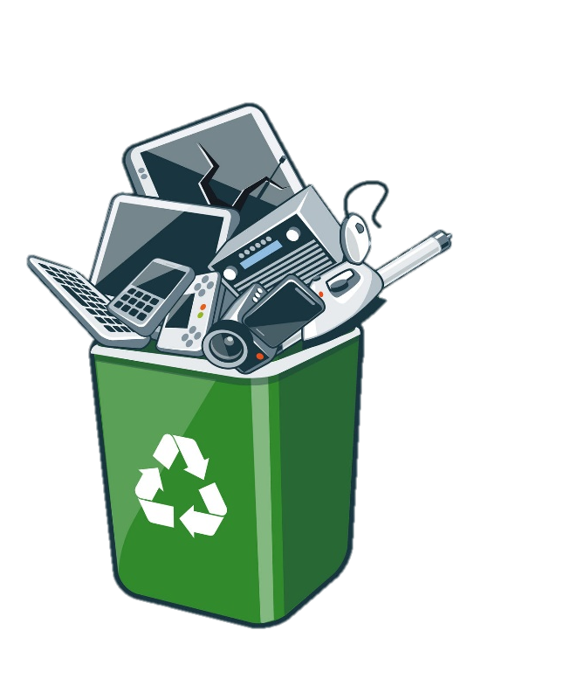
Recycling guide
E-WASTE: A NEW ENVIROMENTAL CHALLENGE
Gabriele Dominelli I4AA
Gabriel Mendonça I4AC
SAMT 13.12.2018
PDI MPT 4A

Slide 2

Summary
E-Waste in general
Hard Disks
What are
How recycling works
Mother Boards
What are
How recycling works
Personal Considerations

Slide 3
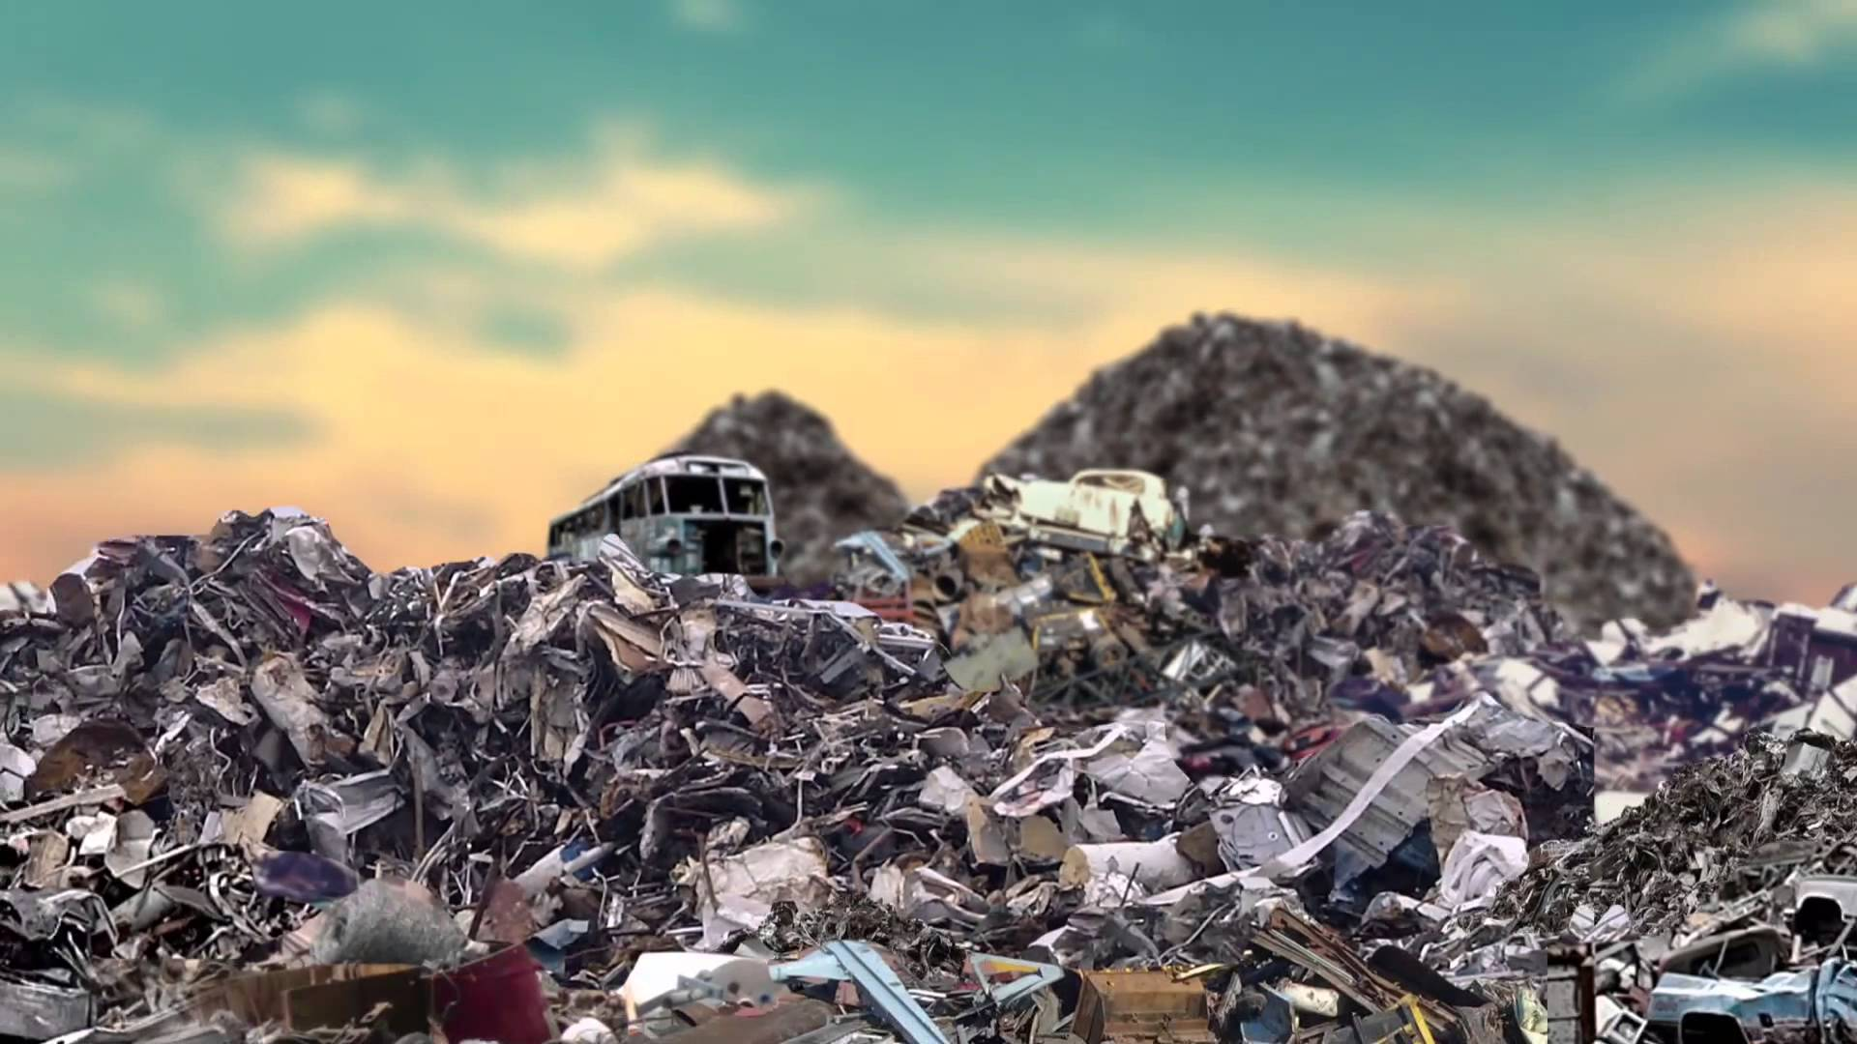
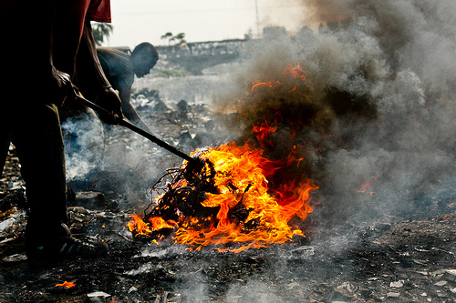
E-Waste in general
Bad Tecnologies Recycling
Cina
Japan
India
Ghana
Health and enviroment risk

Slide 4

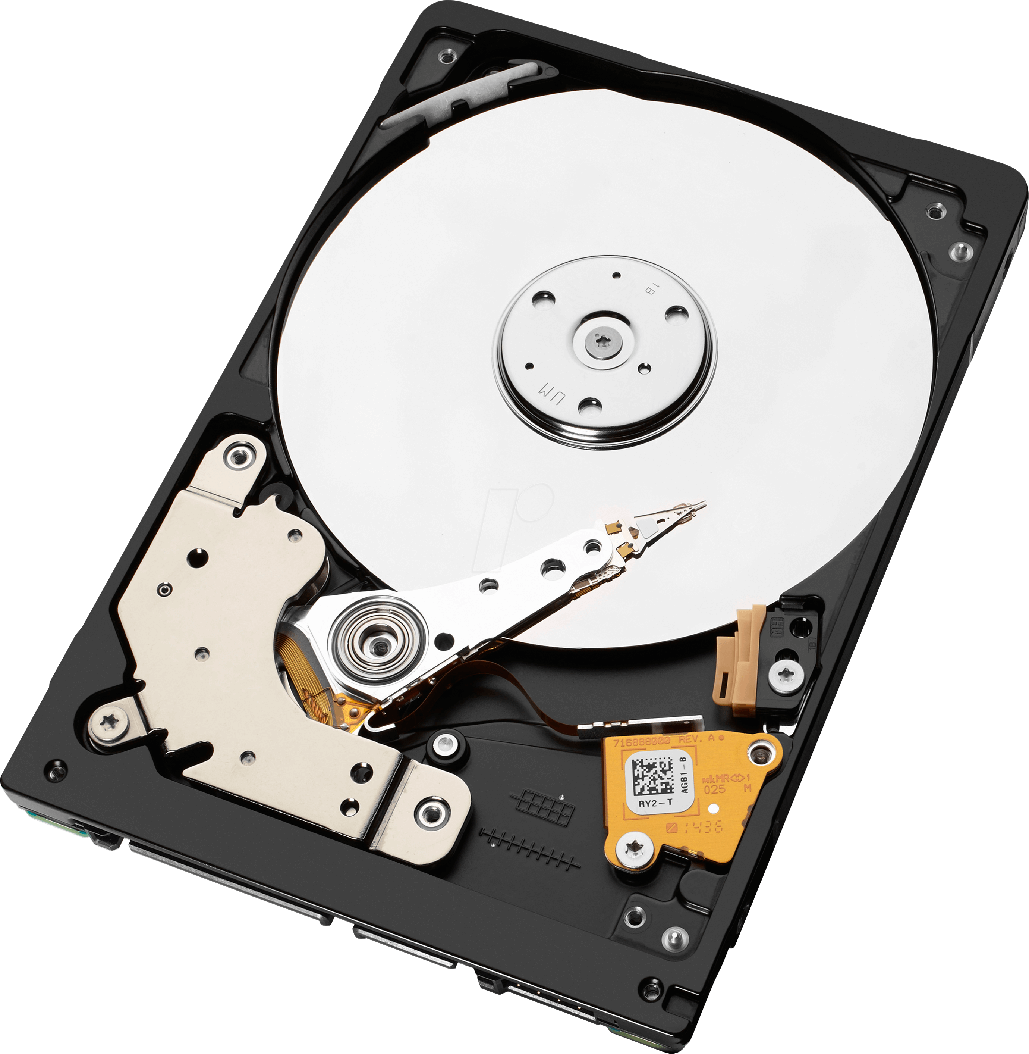

Hard Disks – What are
Disks
Pointer (read/write arm)
Actuator (arm motor)
Spindler (central motor)

Slide 5
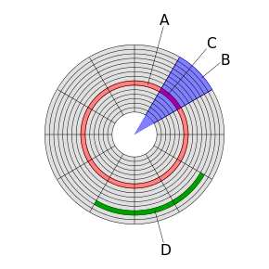
Hard Disks – What are
0
0
1
1
0
0
0
0
0
0
1
0
1
Track
Disk Sector
Sector Track
Cluster
0
1
0
1
0
0
0
0
1
1
0
0
0
0
1
0
0
1
1
0
1
0
0
0
0

Slide 6
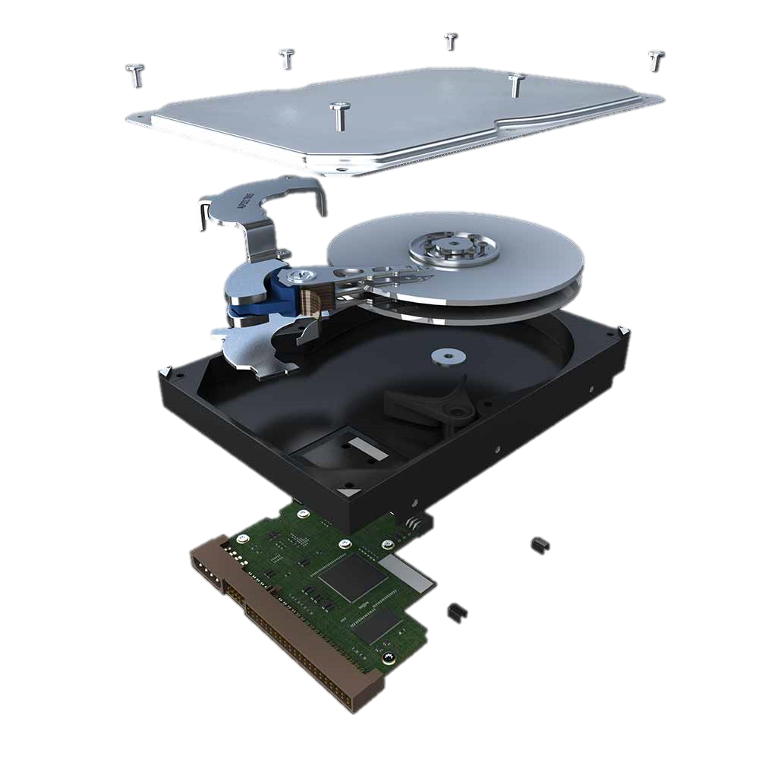



Hard Disks – How recycling works

Slide 7
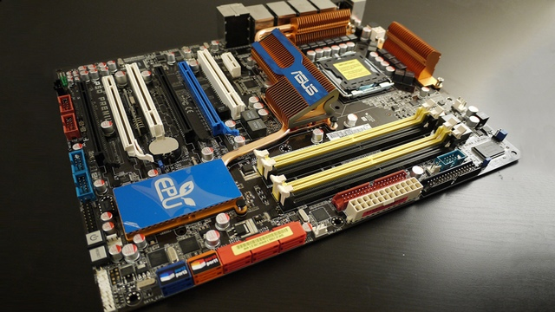
Mother Boards– What are
Essentials

Slide 8
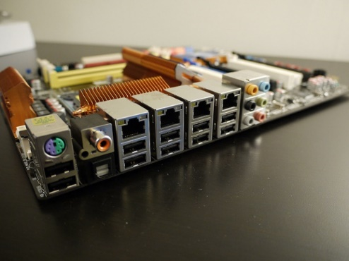
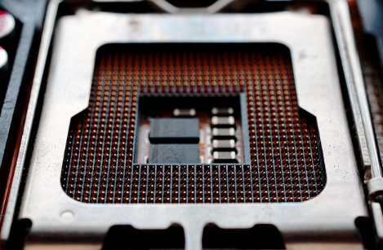
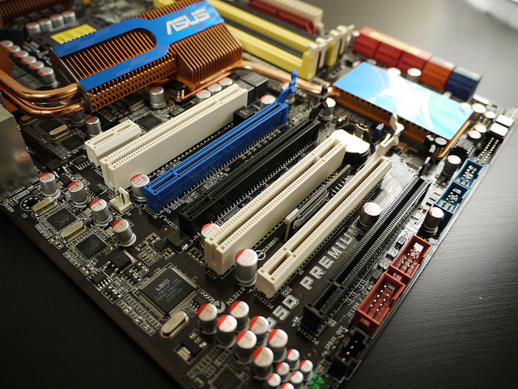
Mother Boards– What are
Slots
Processor
DDR
input

Slide 9

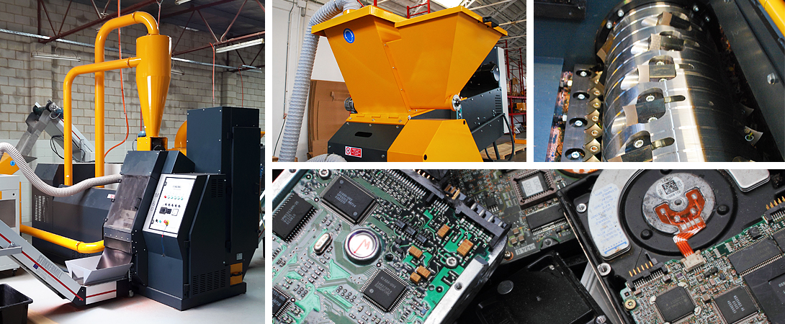
Mother Boards– How recycling works
Acid
Machinery

Slide 10
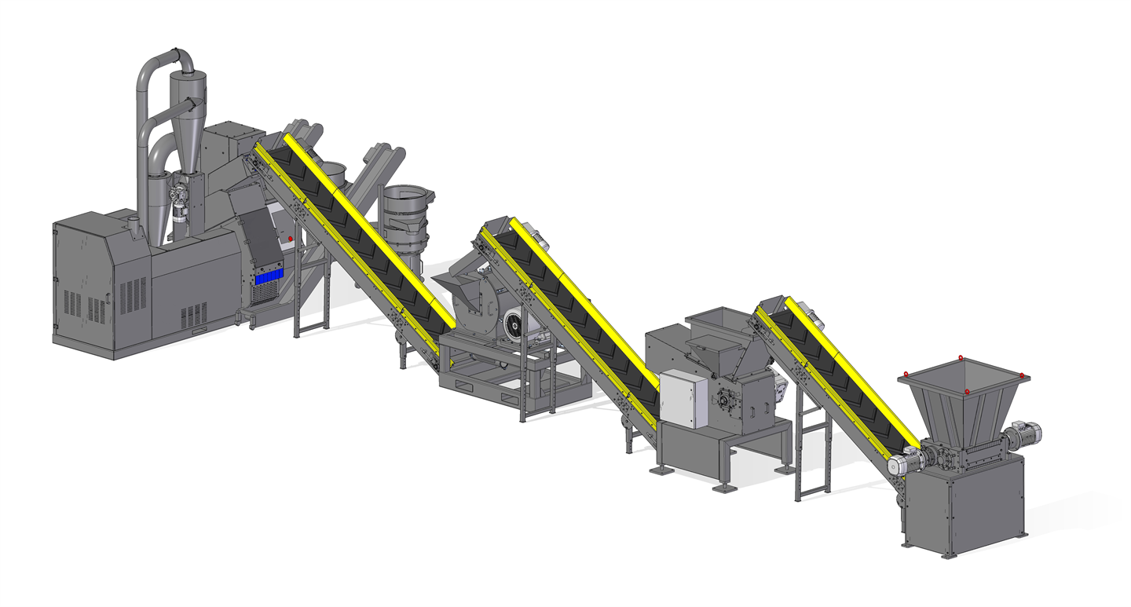
Mother Boards– How recycling works

Slide 11

Personal Considerations

Slide 12
Thank you for listening!
Any question?

